Slide 1

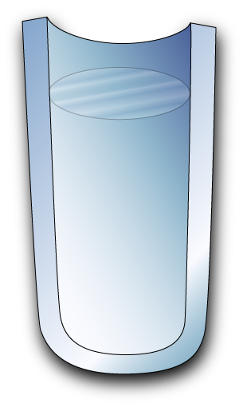
Tantalizing connections in game theory
p_{D}
Evolutionary dynamics providing insight into a related game theory model
Game theory
1
+R
+T
+R
+S
+S
+P
+T
+P
0
t
Prisoner’s dilemma
Consider example T > R > P > S
Consider example T > R > P > S
T, R, P, and S are cell-replication coefficients associated with pairwise collisions
Agents try to maximize payoff
Rationality
Replicators with fitness
Solution := no agent can increase payoff through unilateral change of strategy. E.g., D-vs.-D (T > R and P > S).
Stable homogeneous steady state, i.e. p_{D} → 1 because T > R and P > S.
ESS
Nash equilibrium
Fortune cookie
Each agent obtains less-than-maximum payoff (P < T) owing to other agent’s adoption of strategy D
Enriching in D reduces fitness of both cell types (because T > P and R > S)

Slide 2
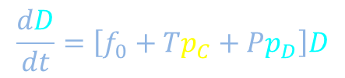
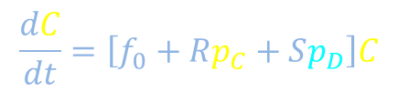



Connections: Mechanistic model and quantitative reasoning
$$\frac{dC}{dt}=\left[f_{0}+Rp_{C}+Sp_{D}\right]C$$
$$\frac{R}{β}$$
Fitness of C
$$\frac{dD}{dt}=\left[f_{0}+Tp_{C}+Pp_{D}\right]D$$
$$\frac{S}{β}$$
Fitness of D
$$\frac{f_{0}}{α}$$
Other cell
+R
+T
$
$
+R
+S
$
You
+S
+P
+T
+P

Slide 3



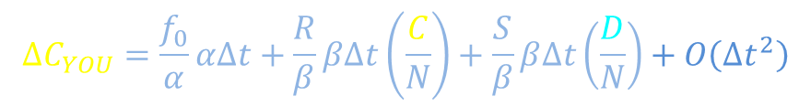

Population dynamics with table of progeny numbers
$$\frac{dC}{dt}=\left[f_{0}+Rp_{C}+Sp_{D}\right]C$$
$$\frac{R}{β}$$
Fitness of C
$$\frac{dD}{dt}=\left[f_{0}+Tp_{C}+Pp_{D}\right]D$$
$$\frac{S}{β}$$
Fitness of D
$$\frac{f_{0}}{α}$$
Other cell
$$t→t+∆t;$$
$$C→C+∆C;$$
$$D→D+∆D;$$
$$N→N+∆N$$
$$∆C_{YOU}=\frac{f_{0}}{α}α∆t+\frac{R}{β}β∆t\left(\frac{C}{N}\right)+\frac{S}{β}β∆t\left(\frac{D}{N}\right)+O\left({∆t}^{2}\right)$$
+R
+S
You

Slide 4
Population dynamics with table of progeny numbers
$$\frac{dC}{dt}=\left[f_{0}+Rp_{C}+Sp_{D}\right]C$$
$$\frac{R}{β}$$
Fitness of C
$$\frac{dD}{dt}=\left[f_{0}+Tp_{C}+Pp_{D}\right]D$$
$$\frac{S}{β}$$
Fitness of D
$$\frac{f_{0}}{α}$$
Other cell
$$t→t+∆t;$$
$$C→C+∆C;$$
$$D→D+∆D;$$
$$N→N+∆N$$
$$∆C_{YOU}=\frac{f_{0}}{α}α∆t+\frac{R}{β}β∆t\left(\frac{C}{N}\right)+\frac{S}{β}β∆t\left(\frac{D}{N}\right)+O\left({∆t}^{2}\right)$$
+R
+S
You

Slide 5
Population dynamics with table of progeny numbers
$$\frac{dC}{dt}=\left[f_{0}+Rp_{C}+Sp_{D}\right]C$$
$$\frac{R}{β}$$
Fitness of C
$$\frac{dD}{dt}=\left[f_{0}+Tp_{C}+Pp_{D}\right]D$$
$$\frac{S}{β}$$
Fitness of D
$$\frac{f_{0}}{α}$$
Other cell
$$t→t+∆t;$$
$$C→C+∆C;$$
$$D→D+∆D;$$
$$N→N+∆N$$
$$∆C_{YOU}=\frac{f_{0}}{α}α∆t+\frac{R}{β}β∆t\left(\frac{C}{N}\right)+\frac{S}{β}β∆t\left(\frac{D}{N}\right)+O\left({∆t}^{2}\right)$$
+R
+S
You

Slide 6
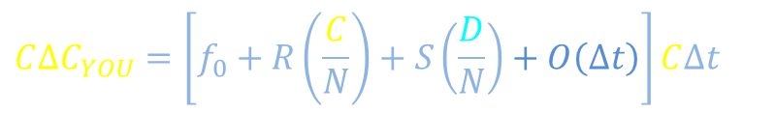
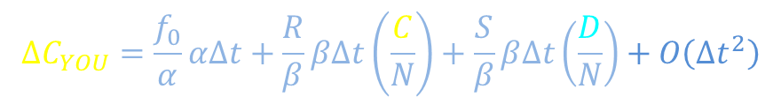

Population dynamics with table of progeny numbers
$$\frac{dC}{dt}=\left[f_{0}+Rp_{C}+Sp_{D}\right]C$$
$$\frac{R}{β}$$
Fitness of C
$$\frac{dD}{dt}=\left[f_{0}+Tp_{C}+Pp_{D}\right]D$$
$$\frac{S}{β}$$
Fitness of D
$$\frac{f_{0}}{α}$$
Other cell
$$t→t+∆t;$$
$$C→C+∆C;$$
$$D→D+∆D;$$
$$N→N+∆N$$
$$∆C_{YOU}=\frac{f_{0}}{α}α∆t+\frac{R}{β}β∆t\left(\frac{C}{N}\right)+\frac{S}{β}β∆t\left(\frac{D}{N}\right)+O\left({∆t}^{2}\right)$$
$$O\left({∆t}^{2}\right)≔stuff {∆t}^{2}+stuff{∆t}^{3}+stuff{∆t}^{4}+⋯$$
+R
$$C∆C_{YOU}=\left[f_{0}+R\left(\frac{C}{N}\right)+S\left(\frac{D}{N}\right)+O\left(∆t\right)\right]C∆t$$
+R
+S
You
$$∆C−O\left({∆t}^{2}\right)$$
+S
$$O\left({∆t}^{2}\right)≔stuff {∆t}^{2}+stuff{∆t}^{3}+stuff{∆t}^{4}+⋯$$
(Purple “stuff” need not be same as blue “stuff”)

Slide 7
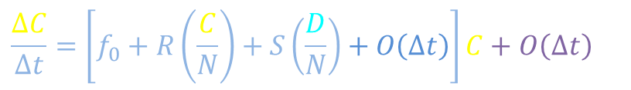
Population dynamics with table of progeny numbers
$$\frac{dC}{dt}=\left[f_{0}+Rp_{C}+Sp_{D}\right]C$$
$$\frac{R}{β}$$
Fitness of C
$$\frac{dD}{dt}=\left[f_{0}+Tp_{C}+Pp_{D}\right]D$$
$$\frac{S}{β}$$
Fitness of D
$$\frac{f_{0}}{α}$$
Other cell
$$t→t+∆t;$$
$$C→C+∆C;$$
$$D→D+∆D;$$
$$N→N+∆N$$
$$∆C_{YOU}=\frac{f_{0}}{α}α∆t+\frac{R}{β}β∆t\left(\frac{C}{N}\right)+\frac{S}{β}β∆t\left(\frac{D}{N}\right)+O\left({∆t}^{2}\right)$$
$$O\left({∆t}^{2}\right)≔stuff {∆t}^{2}+stuff{∆t}^{3}+stuff{∆t}^{4}+⋯$$
+R
$$C∆C_{YOU}=\left[f_{0}+R\left(\frac{C}{N}\right)+S\left(\frac{D}{N}\right)+O\left(∆t\right)\right]C∆t$$
+R
+S
You
$$∆C−O\left({∆t}^{2}\right)$$
+S
$$\frac{∆C}{∆t}=\left[f_{0}+R\left(\frac{C}{N}\right)+S\left(\frac{D}{N}\right)+O\left(∆t\right)\right]C+O\left(∆t\right)$$

Slide 8





Population dynamics with table of progeny numbers
$$\frac{dC}{dt}=\left[f_{0}+Rp_{C}+Sp_{D}\right]C$$
$$\frac{R}{β}$$
Fitness of C
$$\frac{dD}{dt}=\left[f_{0}+Tp_{C}+Pp_{D}\right]D$$
$$\frac{S}{β}$$
Fitness of D
$$\frac{f_{0}}{α}$$
Other cell
$$t→t+∆t;$$
$$C→C+∆C;$$
$$D→D+∆D;$$
$$N→N+∆N$$
$$\frac{T}{β}$$
$$∆C_{YOU}=\frac{f_{0}}{α}α∆t+\frac{R}{β}β∆t\left(\frac{C}{N}\right)+\frac{S}{β}β∆t\left(\frac{D}{N}\right)+O\left({∆t}^{2}\right)$$
$$\frac{R}{β}$$
$$O\left({∆t}^{2}\right)≔stuff {∆t}^{2}+stuff{∆t}^{3}+stuff{∆t}^{4}+⋯$$
+R
+T
$$\frac{P}{β}$$
$$C∆C_{YOU}=\left[f_{0}+R\left(\frac{C}{N}\right)+S\left(\frac{D}{N}\right)+O\left(∆t\right)\right]C∆t$$
$$\frac{f_{0}}{α}$$
$$\frac{S}{β}$$
+R
+S
You
$$∆C−O\left({∆t}^{2}\right)$$
+S
+P
$$\frac{∆C}{∆t}=\left[f_{0}+R\left(\frac{C}{N}\right)+S\left(\frac{D}{N}\right)+O\left(∆t\right)\right]C+O\left(∆t\right)$$
+T
+P

Slide 9
Evolution resulting from repeated games
$$\frac{dC}{dt}=\left[f_{0}+Rp_{C}+Sp_{D}\right]C$$
$$\frac{R}{β}$$
Fitness of C
$$\frac{dD}{dt}=\left[f_{0}+Tp_{C}+Pp_{D}\right]D$$
$$\frac{S}{β}$$
Fitness of D
$$\frac{f_{0}}{α}$$
Evolutionary game theory
Other cell
Partner 2
Game theory
$
$
$
+R
+T
+R
+T
+R
+S
+R
+S
You
Partner 1
+S
+P
+S
+P
+T
+P
+T
+P

Slide 10



Quantitative reasoning
What propositions might we model? How might conclusions depend on our propositions?
Population dynamics
Business payoff analysis
Yes
Proposition 1: Consequences depend on social context
Yes
$
?
+R
+T
$
+R
+T
+R
+S
+R
+S
+S
+P
$
+S
+P
+T
+P
+T
+P
No
Proposition 2: Strategy decisions based on social context
Yes
Sloppy guess: Similarities not expected in conclusions for Pr. 1 vs. Pr. 1 and Pr. 2
Recall prisoner’s dilemma examples (T > R > P > S): Denim is eventually prevalent.
Cell population eventually denim rich
Both agents choose denim strategy
?

Slide 11
Quantitative reasoning
What propositions might we model? How might conclusions depend on our propositions?
Population dynamics
Business payoff analysis
Yes
Proposition 1: Consequences depend on social context
Yes
$
?
+R
+T
$
+R
+T
+R
+S
+R
+S
+S
+P
$
+S
+P
+T
+P
+T
+P
No
Proposition 2: Strategy decisions based on social context
Yes
Sloppy guess: Similarities not expected in conclusions for Pr. 1 vs. Pr. 1 and Pr. 2
Recall prisoner’s dilemma examples (T > R > P > S): Denim is eventually prevalent.
Cell population eventually denim rich
Both agents choose denim strategy
?

Slide 12
Quantitative reasoning
What propositions might we model? How might conclusions depend on our propositions?
Population dynamics
Business payoff analysis
Yes
Proposition 1: Consequences depend on social context
Yes
$
?
+R
+T
$
+R
+T
+R
+S
+R
+S
+S
+P
$
+S
+P
+T
+P
+T
+P
No
Proposition 2: Strategy decisions based on social context
Yes
Sloppy guess: Similarities not expected in conclusions for Pr. 1 vs. Pr. 1 and Pr. 2
Recall prisoner’s dilemma examples (T > R > P > S): Denim is eventually prevalent.
Cell population eventually denim rich
Both agents choose denim strategy
?
Repetition of Pr. 1 can yield conclusions that seem to have “similarity” with applying Pr. 1 and Pr. 2 once. Beware that time can compensate for lack of thinking.

Slide 13
Quantitative reasoning
What propositions might we model? How might conclusions depend on our propositions?
Population dynamics
Business payoff analysis
Yes
Proposition 1: Consequences depend on social context
Yes
$
?
+R
+T
$
+R
+T
+R
+S
+R
+S
+S
+P
$
+S
+P
+T
+P
+T
+P
No
Proposition 2: Strategy decisions based on social context
Yes
Sloppy guess: Similarities not expected in conclusions for Pr. 1 vs. Pr. 1 and Pr. 2
Recall prisoner’s dilemma examples (T > R > P > S): Denim is eventually prevalent.
Cell population eventually denim rich
Both agents choose denim strategy
?
Repetition of Pr. 1 can yield conclusions that seem to have “similarity” with applying Pr. 1 and Pr. 2 once. Beware that time can compensate for lack of thinking.

Slide 14
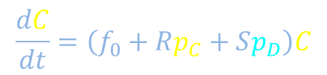
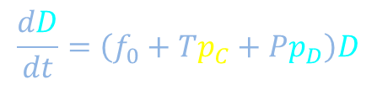
Connections: Mechanistic model and quantitative reasoning
$$\frac{dC}{dt}=\left(f_{0}+Rp_{C}+Sp_{D}\right)C$$
$$\frac{R}{β}$$
Fitness of C
$$\frac{dD}{dt}=\left(f_{0}+Tp_{C}+Pp_{D}\right)D$$
$$\frac{S}{β}$$
Fitness of D
$$\frac{f_{0}}{α}$$
Other cell
+R
+T
$
$
+R
+S
$
You
+S
+P
+T
+P

Slide 15

Population dynamics with payoff matrix
$$\frac{dC}{dt}=\left(f_{0}+Rp_{C}+Sp_{D}\right)C$$
$$\frac{R}{β}$$
Fitness of C
$$\frac{dD}{dt}=\left(f_{0}+Tp_{C}+Pp_{D}\right)D$$
$$\frac{S}{β}$$
Fitness of D
$$\frac{f_{0}}{α}$$
Other cell
$$t→t+∆t;$$
$$C→C+∆C;$$
$$D→D+∆D;$$
$$N→N+∆N$$
$$∆C_{YOU}=\frac{f_{0}}{α}α∆t+\frac{R}{β}β∆t\left(\frac{C}{N}\right)+\frac{S}{β}β∆t\left(\frac{D}{N}\right)+O\left({∆t}^{2}\right)$$
$$O\left({∆t}^{2}\right)≔stuff {∆t}^{2}+stuff{∆t}^{3}+stuff{∆t}^{4}+⋯$$
+R
$$C∆C_{YOU}=\left[f_{0}+R\left(\frac{C}{N}\right)+S\left(\frac{D}{N}\right)+O\left(∆t\right)\right]C∆t$$
+R
+S
You
$$∆C−O\left({∆t}^{2}\right)$$
+S

Slide 16
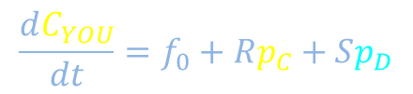
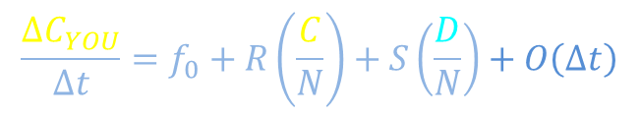
Population dynamics with payoff matrix
$$\frac{dC}{dt}=\left(f_{0}+Rp_{C}+Sp_{D}\right)C$$
$$\frac{R}{β}$$
Fitness of C
$$\frac{dD}{dt}=\left(f_{0}+Tp_{C}+Pp_{D}\right)D$$
$$\frac{S}{β}$$
Fitness of D
$$\frac{f_{0}}{α}$$
Them
How many progeny do you make in a time interval Δt?
$$∆C_{YOU}=\frac{f_{0}}{α}α∆t+\frac{R}{β}β∆t\left(\frac{C}{N}\right)+\frac{S}{β}β∆t\left(\frac{D}{N}\right)+O\left({∆t}^{2}\right)$$
$$O\left({∆t}^{2}\right)≔stuff {∆t}^{2}+stuff{∆t}^{3}+stuff{∆t}^{4}+⋯$$
+R
$$\frac{∆C_{YOU}}{∆t}=f_{0}+R\left(\frac{C}{N}\right)+S\left(\frac{D}{N}\right)+O\left(∆t\right)$$
+R
+S
You
+S
$$\frac{dC_{YOU}}{dt}=f_{0}+Rp_{C}+Sp_{D}$$

Slide 17

Population dynamics with payoff matrix
$$\frac{dC}{dt}=\left(f_{0}+Rp_{C}+Sp_{D}\right)C$$
$$\frac{R}{β}$$
Fitness of C
$$\frac{dD}{dt}=\left(f_{0}+Tp_{C}+Pp_{D}\right)D$$
$$\frac{dD}{dt}=\left(f_{0}+Tp_{C}+Pp_{D}\right)D$$
$$\frac{S}{β}$$
Fitness of D
Fitness of D
$$\frac{f_{0}}{α}$$
Them
How many progeny do you make in a time interval Δt?
$$∆C_{YOU}=\frac{f_{0}}{α}α∆t+\frac{R}{β}β∆t\left(\frac{C}{N}\right)+\frac{S}{β}β∆t\left(\frac{D}{N}\right)+O\left({∆t}^{2}\right)$$
$$O\left({∆t}^{2}\right)≔stuff {∆t}^{2}+stuff{∆t}^{3}+stuff{∆t}^{4}+⋯$$
+R
+T
$$\frac{∆C_{YOU}}{∆t}=f_{0}+R\left(\frac{C}{N}\right)+S\left(\frac{D}{N}\right)+O\left(∆t\right)$$
+R
+S
You
+S
+P
$$\frac{dC_{YOU}}{dt}=f_{0}+Rp_{C}+Sp_{D}$$
+T
+P

Slide 18
Backup meditator

